Slide 1
HTML
MCNDHS
Ms. Eng

Slide 2
AIM: HOW DO WE LINK IMAGES FROM OUR REPOSITORY?
Do now:
OPEN: Notepad
<!DOCTYPE html>
<html>
<head>
<title></title>
<head>
<body>
</body>
</html>
Daily Grade:
On-time/attendance/not leaving the classroom: 25%
Cellphones: 25%
Notes:25%
Classwork/Homework: 25%

Slide 3
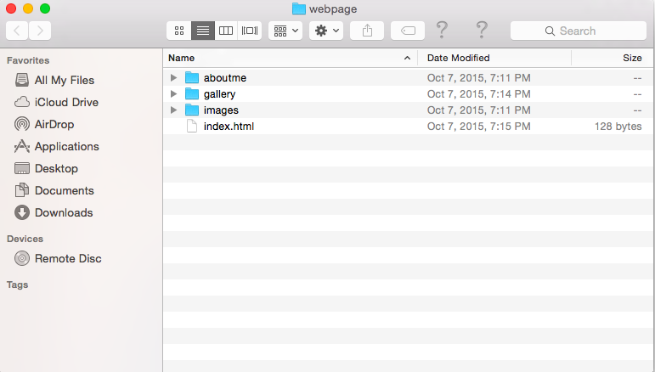
YOUR REPOSITORY

Slide 4

CLICK THE IMAGE FOLDER
Notice nothing appears…
why….?

Slide 5

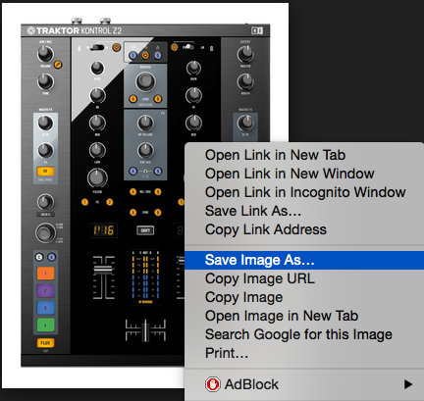
TAKING A PHOTO FROM THE INTERNET..

Slide 6
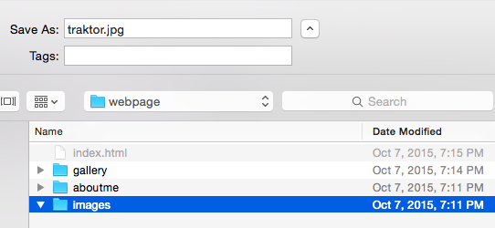

SAVING TECHNIQUES
make sure you save it with an appropriate name!
checklist:
1) Naming should be related to image.
2) If you want to put a space, use an underscore
(ex: number one
number_one

Slide 7
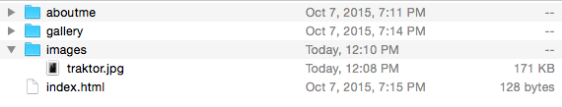
SAVING

Slide 8
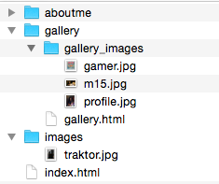
ACTIVITY
Create a subfolder within the gallery folder that contains:
6 images.jpg

